Slide 1
Computers and Data Security

Slide 2
Overview
History and Background
Problems in Society
Potential Solutions
Future Changes
References
Questions

Slide 3
History and Background

Slide 4

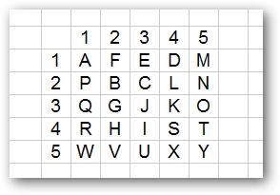
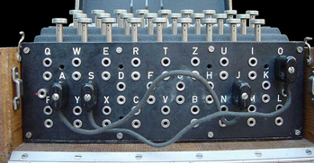
Encryption
scytale
Polybus Square
Enigma
Notes:
https://www.howtogeek.com/howto/33949/htg-explains-what-is-encryption-and-how-does-it-work/

Slide 5
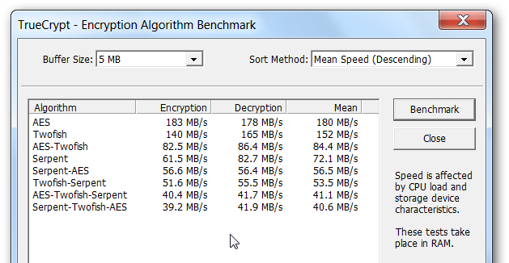
Encryption (Cont.)

Slide 6
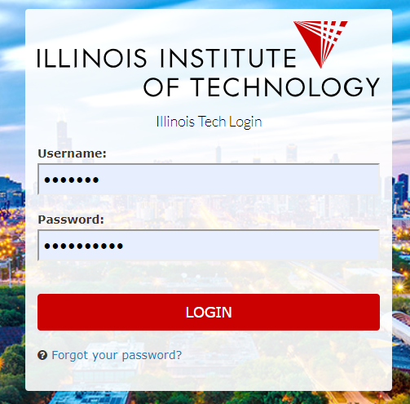

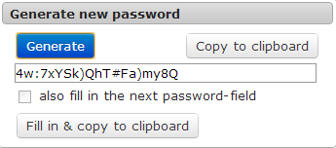
Passkeys

Slide 7


Accessibility
Archives
Safety deposit boxes
Isolated servers
Multi-factor authentication

Slide 8
Problems in Society

Slide 9

Cyber Attacks
Confidentiality
Integrity
Accessibility
C
I
A
Cost-Benefit Analysis

Slide 10
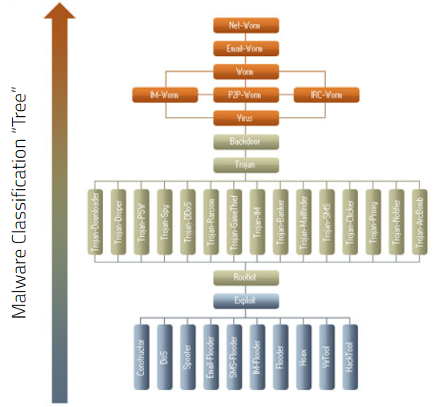

Malware
Stuxnet (2009-2010)
scvhost.exe

Slide 11
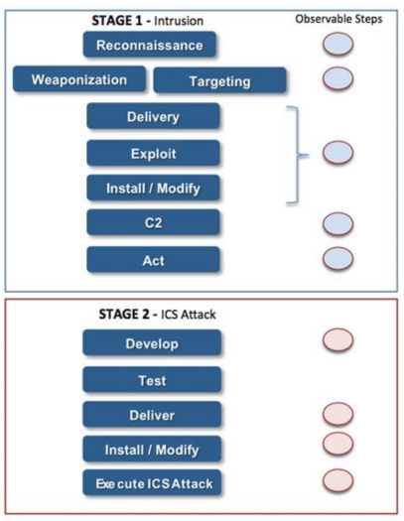
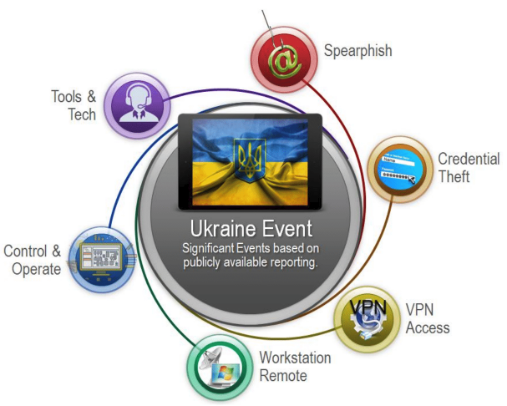
Training (or lack thereof)
Ukrainian Power Grid Attack (2015)

Slide 12

Exploits
MS DDE Protocol
Cisco Routers (27 Feb 2019)
Meltdown and Spectre

Slide 13
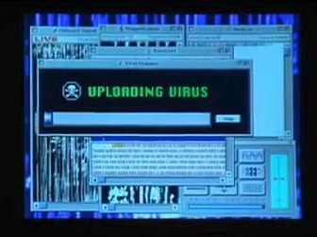
Bad Security & Education
“Mystic” movie portrayals
Lack of care & thought
“Out of sight, out of mind”

Slide 14
Potential Solutions

Slide 15
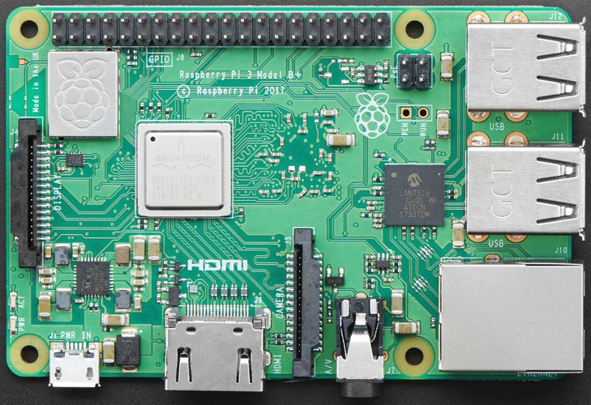
Training & Education
Attack Handling
Break down stereotypes
Teach basic security
STEM in schools

Slide 16
Better Computers
Antivirus Techniques
Machine Learning
Distributed Systems
Attack Handling
Faster computers == harder encryption

Slide 17
Legal Implications
Computer Fraud and Abuse Act (CFAA)
US Digital Millennium Copyright Act (DCMA)
Electronic Communications Privacy Act (ECPA)
Notes:
CFAA - cannot access computers without authorization
DCMA - prevent copyright circumvention
ECPA - prevent wiretaps or monitoring electric communications

Slide 18
Future Years

Slide 19
Evolving Problems
Computational power
Always-on devices
Big data
IoT Devices
Connectivity
Rapid Tech Development
Notes:
Rapid tech development prevents thorough testing

Slide 20
Summary
History and Background
Problems in Society
Potential Solutions
Future Changes

Slide 21
Questions?

Slide 22
References
https://usa.kaspersky.com/resource-center/threats/malware-classifications
https://www.howtogeek.com/howto/33949/htg-explains-what-is-encryption-and-how-does-it-work/
https://en.wikipedia.org/wiki/Information_privacy_law
https://docubank.expert/blog/5-best-data-security-technologies-right-now
Annachhatre, Chinmayee, Thomas H. Austin, and Mark Stamp. ""Hidden Markov models for malware classification."" Journal of Computer Virology and Hacking Techniques (2015)
Analysis of the cyber attack on the Ukrainian power grid."" Electricity Information Sharing and Analysis Center (E-ISAC) 2016.
Falliere, Nicolas, Liam O. Murchu, and Eric Chien. ""W32. stuxnet dossier.""White paper, Symantec Corp., Security Response (2011).

